Slide 1


Introduction To Unsupervised Learning

Slide 2


Slide 3
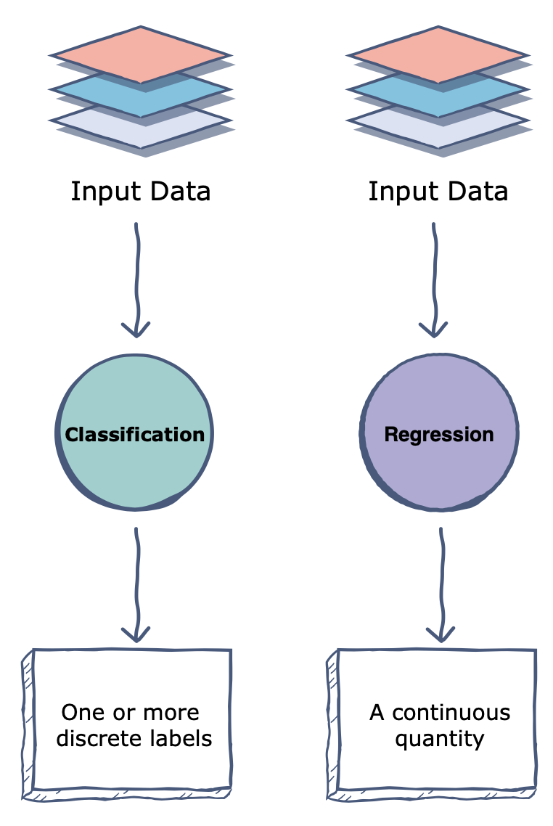
Target

Slide 5
Euclidean Distance

Slide 6
Manhattan Distance

Slide 7
Cosine Distance

